Slide 1
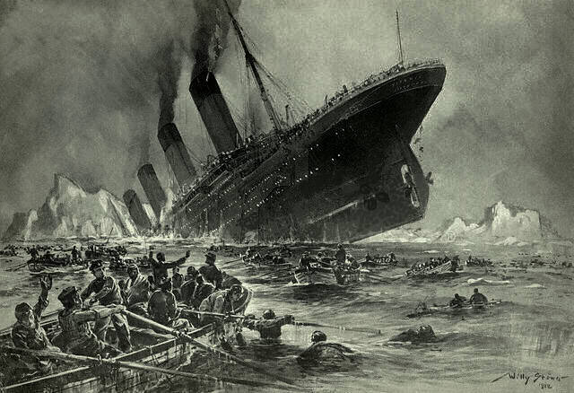
Titanic Survival Classification
Lab 2

Slide 2
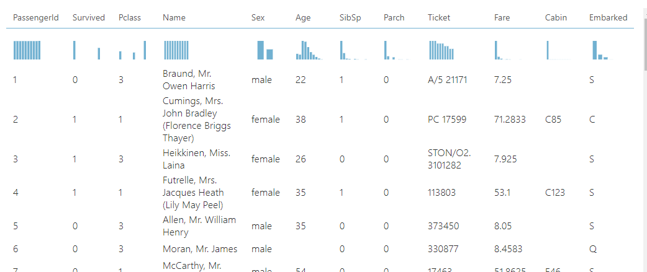
Dataset Description
Dataset contains passenger information of passengers on board the Titanic.
891 observations and 12 attributes, with Survived being the target attribute.
SipSp = No. of Siblings and Spouses
Parch = No. of Parents and Children
Embarked = Port in which the passenger boarded the Titanic

Slide 3
Exploratory Data Analysis

Slide 4
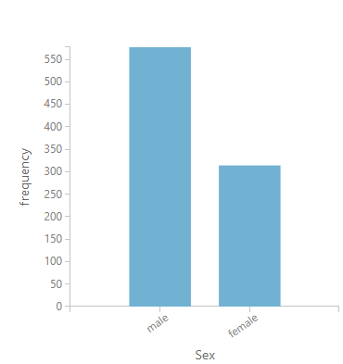
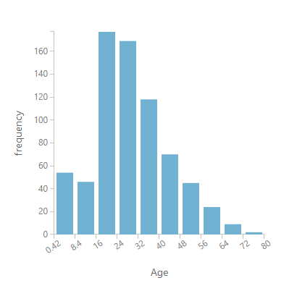
Most were males; Age distribution is positively skewed, with most being young adults.

Slide 5
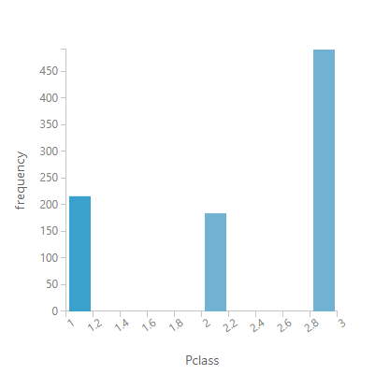
Most passengers were in the third class

Slide 6
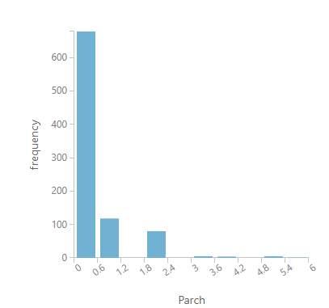
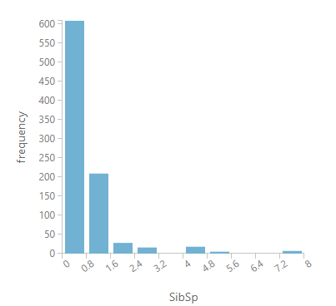
Distribution of Parents and Children (Parch) & Siblings and Spouses (SibSp) is positively skewed

Slide 7
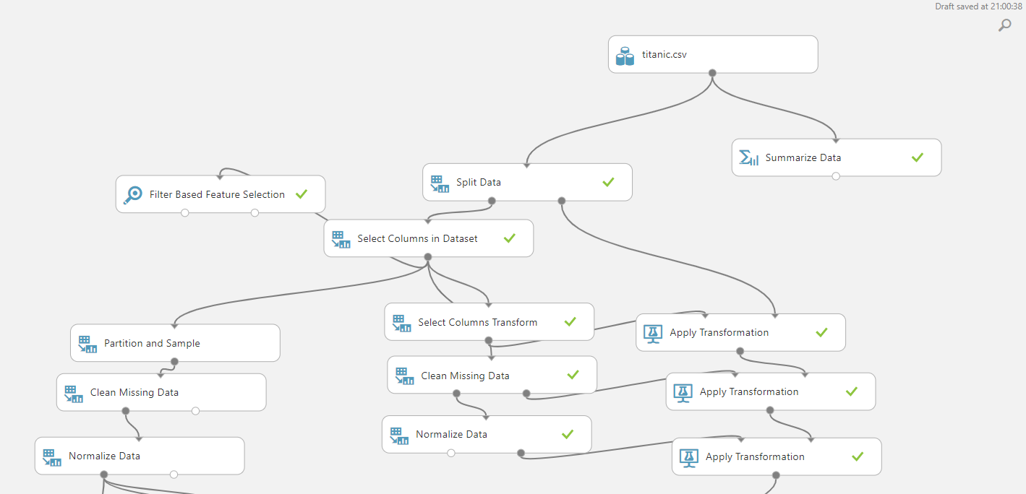

Data Preprocessing
Data was split 80:20; Stratified split to ensure same class distribution
PassengerId, Name, ticket and cabin features were removed
MICE used to impute missing Age data
Numerical features were standardized

Slide 8
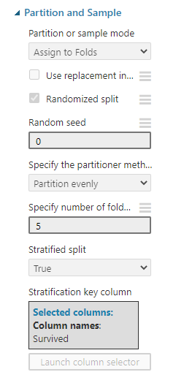
Data Preprocessing
5-Fold CV was performed on the training split to allow for cross-validated hyperparameter tuning
For each split in k-fold CV, data transforms are fitted to that split’s training fold. This prevents data leakage during k-fold CV.
For inference, data transformers are refitted to the entire training split.

Slide 9
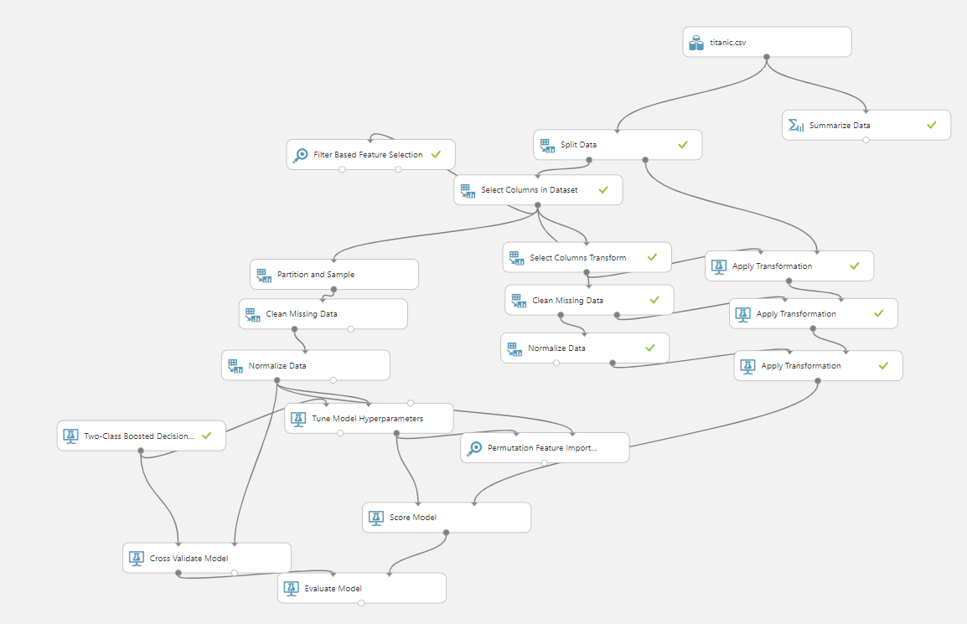
Overall Workflow

Slide 10
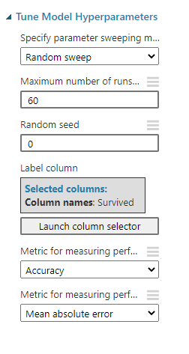
Hyperparameter Tuning
Random Search algorithm is used to find the optimal hyperparameters
To reduce risk of overfitting, the hyperparameter search is done using k-fold CV.

Slide 11
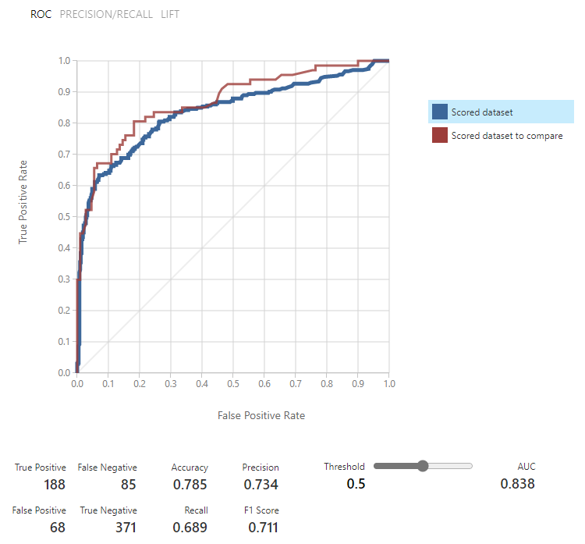
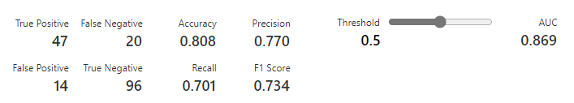
Model: Logistic Regression
Mean Accuracy of 78.5% on CV folds
Accuracy of 80.8% on hold-out set suggests model is able to generalize well as it has not overfitted
Model has higher precision than recall

Slide 12
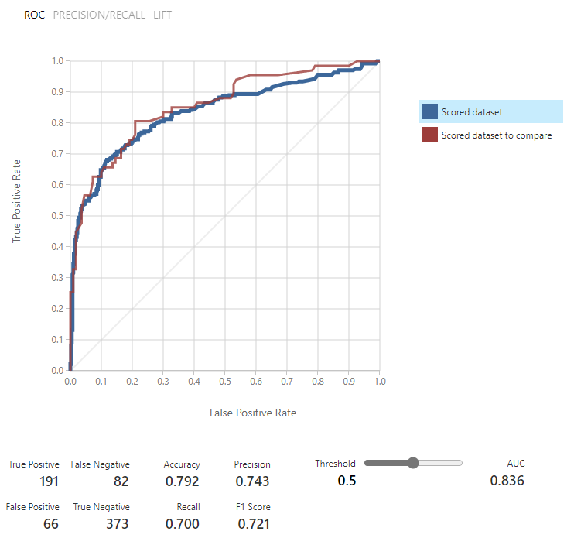
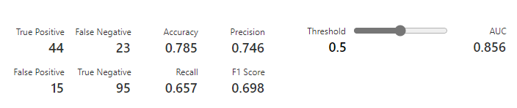
Model: SVM
Mean Accuracy of 79.2% on CV folds, an improvement over Logistic Regression
Accuracy of 78.5% on the hold out set suggests model might be overfitting

Slide 13
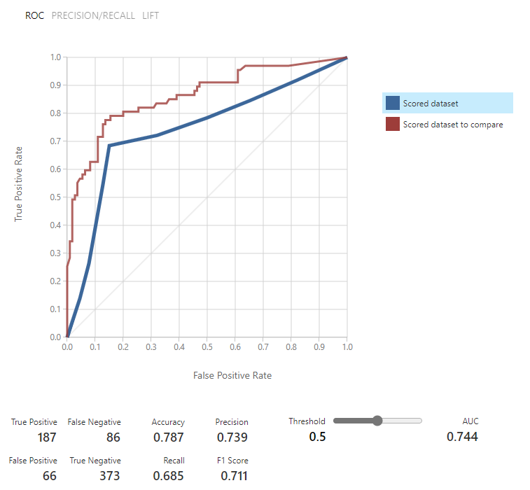
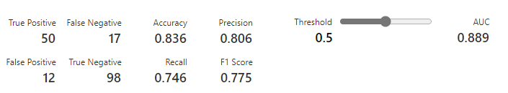
Model: Boosted Decision Tree
Mean accuracy of 78.7% on CV folds, is a slight improvement over Logistic Regression
Accuracy of 83.6% on hold-out set; Model does not appear to be overfitting

Slide 14
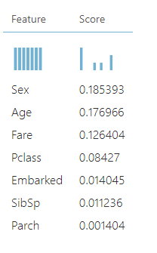
Feature Importances
Permutation importance was used to generate feature importances
Model Used: Boosted Decision Trees
Sex and Age were deemed the most important features when predicting survival
Makes sense, as women and children were granted priority access to lifeboats during the sinking of the Titanic
Port of Embarkation and Number of Relatives had little impact on the prediction accuracy of the model

Slide 15
References
ML Studio (classic): Partition and Sample - Azure | Microsoft Docs
ML Studio (classic): Permutation Feature Importance - Azure | Microsoft Docs
ML Studio (classic): Cross-Validate Model - Azure | Microsoft Docs
Stöwer_Titanic.jpg (640×438) (wikimedia.org)

